Slide 1
Twitter / Media Analysis Argentina
Horacio Nesman
General Assembly

Slide 2
Twitter / Media Analysis
Source: Digital Newspapers from Argentina:
La Nación - http://lanacion.com.ar/
La Voz - www.lavoz.com.ar/
Los Andes - http://losandes.com.ar/
Twitter - http://www.twitter.com
Timeframe: 28/04/17 – 06/05/17

Slide 3
Two Stages
Discover Most Frequent Terms from Media
Perform Twitter Sentiment Analysis on those terms

Slide 4
Media

Slide 5
Media - Get the Data & Terms
Beautiful Soup for:
Webscraping, cleaning and parsing the data
I collected from each Newspaper:
LosAndes (152 articles)
LaNación (1002 articles)
LaVoz (249 articles)
The articles belong to the period: 28/4/2017 – 6/5/2017

Slide 6
Media - Get the Data & Terms
Prepare the Data:
-Merge the three files
-Mapped values of Art_Label
-Clean characters
Total: 1403 articles
B) Vectorize the text:
Create the Vector Word using sklearn.CountVectorizer
Extract the terms to feed the Twitter Search. Shortlisted by me.

Slide 7
Media - Get the Data & Terms
I shortlisted 20* terms and classified them within the following fields:
Politics (National)
World/Politics
Religion/Politics
Sports/Politics
Sports
*Originally were 21, but I cut 1 as it wasn’t very relevant to the country affairs

Slide 8
Twitter

Slide 9
Twitter – Search the terms
Twitter APIs
Tweepy
Limitations:
Twitter only allows access to 7 days old tweets
Rate Limited: restrictions in the number of calls you can do within a certain time frame
Twitter provides just a sample of tweets (GNIP can provide complete data)
Outcome: 59104 Tweets for the period 28/04/17 – 06/05/17

Slide 10
Twitter – Parse and clean the Tweets
Merge the tweets in one DataFrame
Identify ‘RT’
Clean the text (‘www…’ , ‘http:..’)
Drop duplicates*
Drop tweets with Nan values
Send the DataFrame thru a Language Detector (Langid & Langdetect)
Drop Retweets
Labelled them manually (4196 tweets)
Drop the tweets with Polarity = [‘Neu’, ‘Nan’]
Outcome: 2000 Tweets
(*this is due that different search terms will result in the same tweet)

Slide 11
Twitter – Parse and clean the Tweets
-Some tweets are ambiguous, they include a positive phrase and a negative phrase in the same tweet. Particularly in Sports:
Praise their favourite team and curse against the biggest rival.
(i.e.: “Goooooool hijo de re mil p***, vamos river la c***** de boca, el domingo comemos chancho..”)
Praise their favourite team and curse their own mother or something like that.
(i.e: “Que lindo es ser de River la p*** madre”)
Also there is a lot of irony, in which having a good understanding of the context is key to labelled the sentiment properly.
(i.e.: “Como nos favorece la afa**”)
** afa means Asociación de Fútbol Argentino

Slide 12
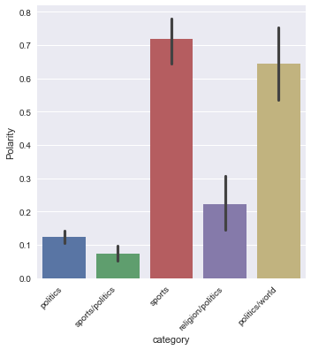
Twitter – Polarity / Categories

Slide 13
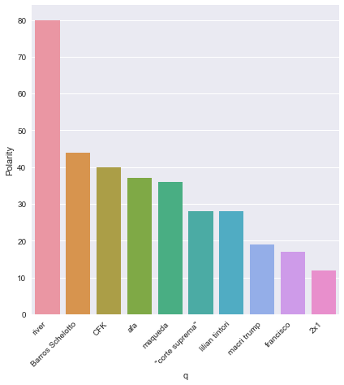
Twitter – Polarity / Terms / Most Positives

Slide 14
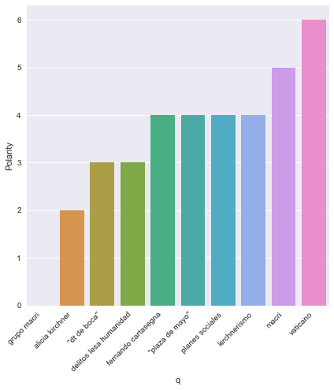
Twitter – Polarity / Terms / Most Negatives

Slide 15
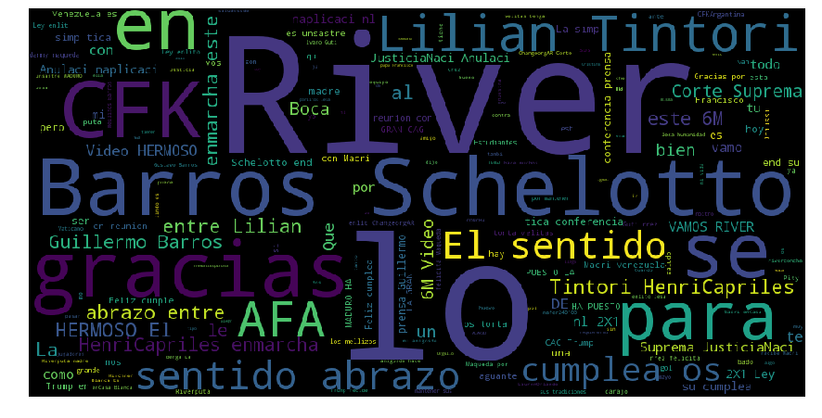
Twitter – Wordcloud - Positives

Slide 16
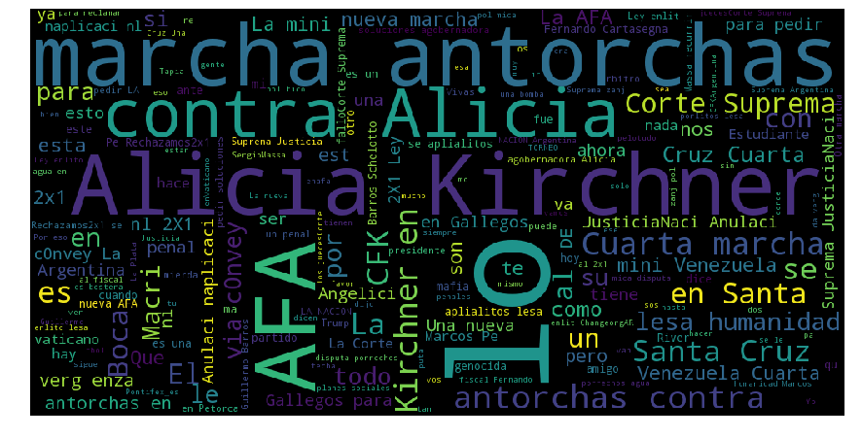
Twitter – Wordcloud - Negatives

Slide 17
Twitter
Sentiment Analysis

Slide 18
Sentiment Analysis – Building a model
Find a model capable to perform a Sentiment Analysis on Tweets in Spanish.
TASS dataset which is a competition organized by the SEPLN (Sociedad Española para Procesamiento del Lenguaje Natural) - www.sepln.org
Size: 10503 labelled tweets
/general-tweets-train-tagged.xml (7219 tweets)
/stompol-tweets-train-tagged.xml (784 tweets)
/politics2013-tweets-test-tagged.xml (2500 tweets)
Reference: Martínez-Cámara, E., Martín-Valdivia, M. T., Ureña-López, L. A., & Mitkov, R. (2015). Polarity classification for Spanish
tweets using the COST corpus. Journal of Information Science, 0165551514566564

Slide 19
Twitter – Sentiment Analysis – Building the model
Prepare the Data Set(I used the TASS dataset for this):
Concatenate into one pd.DataFrame (10503 tweets)
Clean the tweets with ‘Neutral’ or ‘None’ polarity
Final dataset: 7001 tweets

Slide 20
Twitter – Sentiment Analysis – Building the model
I used 3 methods for Vectorising the dataset:
Vectorization means, to transform a text into a Vector, in which each word of the text becomes a feature of the vector
CountVectorizer (binary = False / Frequency)
CountVectorizer (binary = True / Presence)
Tf-idF (weighted) – (Term Freq – Inverse Document Frequency)
These Vectors will be the input to my estimators which are:
I
Random Forest Classifier
Logarithmic Regression

Slide 21
Twitter – Sentiment Analysis – Getting a model
Model / Vectorizer | Train Score | Test Score
RFC / C_Vect (Presence) | 0.6746 | 0.59
Log Reg/ C_Vect (Presence) | 0.6832 | 0.63
RFC / C_Vect (Frequency) | 0.6754 | 0.59
Log Reg / C_Vect (Frequency) | 0.6857 | 0.62
RFC / Tf-idF | 0.6756 | 0.57
Log Reg / Tf-idF | 0.6848 | 0.63

Slide 22
Twitter – Sentiment Analysis – Fitting my data
Model / Vectorizer | Train Score | Test Score
Log Reg/ C_Vect (Presence) | 0.8285 | 0.71
Log Reg / Tf-idF | 0.8245 | 0.7250

Slide 23
Future Steps
Media Analysis
Improve the coding, include more newspapers in my analysis.
Perform Topic Modelling (Latent Dirichlet Allocation)
Twitter Analysis
Increase the database of labelled tweets
Analyse the role of Retweets, what type of sentiments are more popular in RT?
Explore further different tuning parameters
Support Vector Machine models
Research the tweets of particular/influent users on Twitter (Lovers/Haters)

Slide 24
Thanks
https://github.com/hnesman/SA-Correlation-with-Twitter-and-Media

